Slide 1
Digitization of Medical Education
Nasser Abdullah Al Mufarji
Wright State University
EDT 8620
Applied Research for Health Professions Applications
Dr. Albert Painter
29 April, 2015

Slide 2
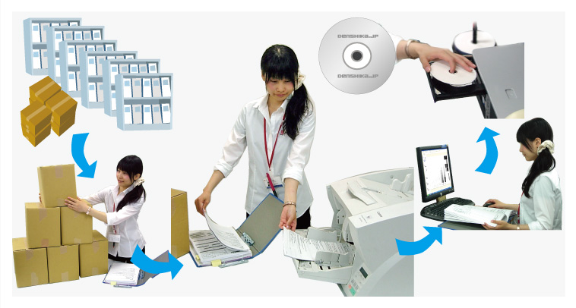
Introduction: Digitization of medical education in the College of Medicine & Health Sciences, Oman by transitioning to a paperless system.
Notes:
This research presentation focuses on the digitization of medical education, proposing that the College of Medicine and Health Sciences at Sultan Qaboos University Oman transition from a paper to digital system. The transition at Sultan Qaboos University Oman exemplifies how a curriculum delivery process can be improved by the implementation of a paperless system. This presentation seeks to identify, expose, and promote the most efficient methods of digitization in academic administrative environments.

Slide 3
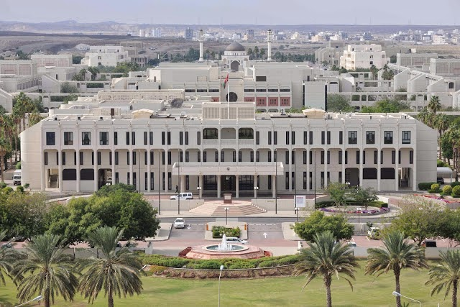
Background: College of Medicine & Health Sciences (COMHSc)is one of the state-sponsored college established in 1986 .
Notes:
The College of Medicine and Health Sciences is one of the first state-sponsored colleges to be established in Oman when the university began accepting admissions in 1986. It has an annual intake of 120 to 130 students in the M.D. program. The total number of staff employed at COMHSc stands at 490, consisting of 75 academics, 325 clinical tutors, 41 administrative staff, and 49 technical staff. In liaison with the university hospital, the college consists of 19 clinical departments and supportive units such as the Administration Office, Medical Education Unit (MEU), and the Examinations Office.

Slide 4
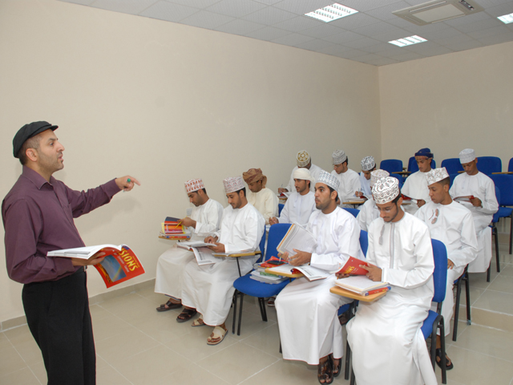
Statement of Problem: The current medical education system requires extensive resources, specifically time, money, and space.
Notes:
The current medical education system requires extensive resources, specifically time, money, and space. Students’ handouts and assessments are all printed out on paper. Lectures are taught using PowerPoint presentations prepared by the instructor, and students are given paper copies of the presentation at the end of the lecture. Students can only access course materials by attending class in person. No videotaping nor online information is otherwise available. This is a problem because not all students are able to attend class due to various reasons, such as illness and personal conflicts.

Slide 5
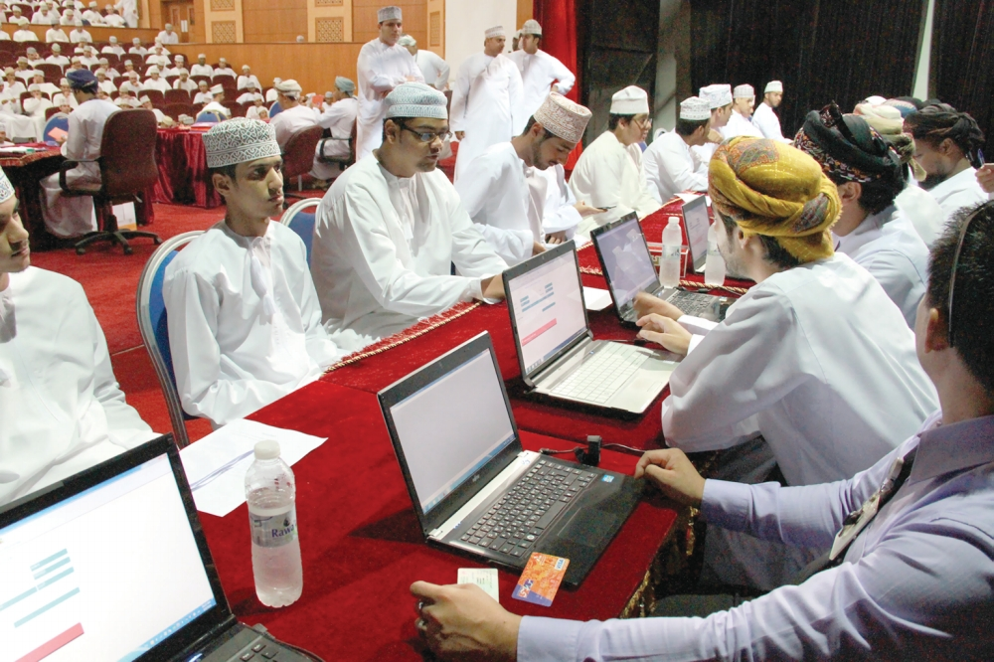
Support for Digitization: The use of mobile devices such as smart phones and iPads should be promoted in the classroom as part of BYOD.
Notes:
The use of mobile devices such as smart phones and iPads should be promoted in the classroom as part of the Bring Your Own Device (BYOD) model. Additionally, students could access course materials in an e-book format. Those students who cannot come to campus to submit their assignments can do so electronically from home through an electronic learning management system.

Slide 6
Case Studies for Digitization: Lynn University in Florida started going paperless in the Fall 2013 by transitioning to iPad Minis for all their courses.
Notes:
Lynn University in Florida started going paperless in the Fall 2013 by transitioning to iPad Minis for all of their courses. The devices changed the way Lynn’s faculty delivered their course materials. Students were able to collaborate with their instructor by sharing the iPad screen that was projected for all students to see in the classroom. The instructor was no longer tied up with the screen as he/she could move freely with the iPad while explaining information to the students. Students were more involved during the session by interacting with other students using this technology.

Slide 7
Radford University: This is another example of an institution that has implemented a paperless curriculum in a Biology class.
Notes:
The university has implemented a Bring Your Own Devise (BYOD) program and that is one of the methods for implementing a high-tech learning environment. The most common software used for this Biology class is AOL Instant Messenger, which is a free download from the Internet. Students have an instant connection to their professors outside the classroom through this software. Students who are unable to attend class inform their professor through AOL. . This provides an environment whereby students are free to communicate with instructors virtually rather than face-to-face.

Slide 8
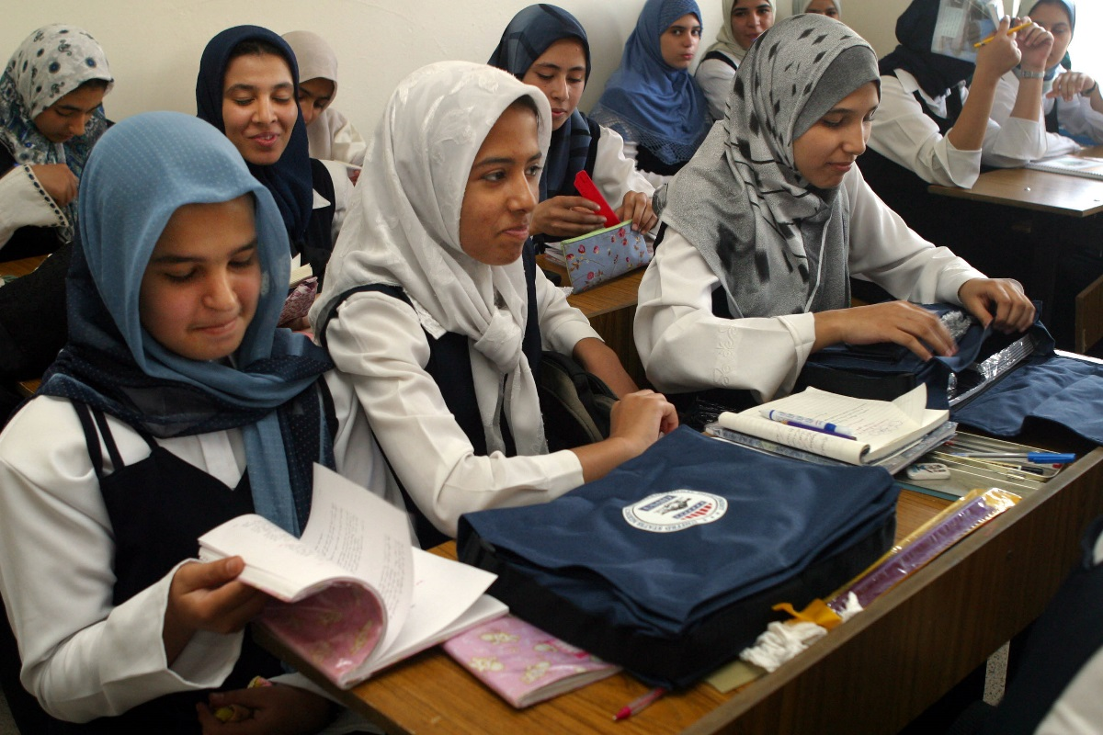
Need for Change: In this time of technological change, there is a need to modify the method of teaching and assessment in COMHSc .
Notes:
In this time of technological change, there is a need to modify the method of teaching and assessment in the College of Medicine and Health Sciences. Students should be engaged in the use of technology to improve their performance by having access to the information before they attend class. Additionally, faculty should also change the method of teaching to align with the current change in education technology.

Slide 9
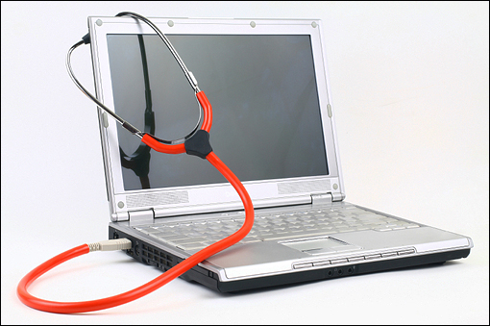
Conclusion: Medicine, as a profession is changing at a rapid pace. Digitization must be at the core of the learning process to achieve this objective.
Notes:
Medicine, as a profession is changing at a rapid pace. The teaching and learning required to train doctors must appropriately mirror that process in order to produce practitioners who are able to practice at the most up-to-date level. Digitization must be at the core of the learning process in order to achieve that objective. Though resistance to change may impede this progression, benefits of digitization for COMHSc outweigh the challenges. Significant cost savings, increased student satisfaction, and more efficient use of staff time and space provide evidence that this transition will move COMHSc in the right direction.

Slide 10
Lessons Learned: The following reflection summarizes how various real-life experiences in this course would help improve education system in Oman .
Notes:
The

Slide 11
ExamSoft: It is a software for managing assessments by creating questions, administration, scoring and analysis.
Notes:
This is the current software that the School of Medicine at WSU is using. I liked the idea that the school of medicine first created an in-house software called Flight. It includes features such as a question bank, as well as sections for evaluation and testing. In-house exam software provides flexibility for both students and faculty. Students would have the comfort of doing examinations by using the latest technology such as iPads. With this technology, faculty prefer easy-to-use software to manage assessment and engage with students. Though there are security issues involved in conducting online assessments, there are more benefits than drawbacks. An increase in physical storage space, a reduction in the cost of printing, and improved efficiency for conducting examinations are some of the benefits of using this technology.

Slide 12
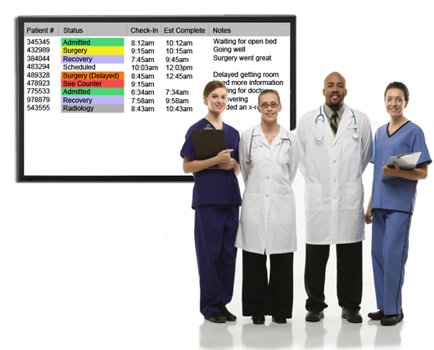
Residency Management Suit (RMS): It is a software for managing residents by tracking their evaluation, feedback, courses completed, duty hours and conferences attended.
Notes:
Residency Management Suit (RMS) is a software designed to provide different information at any time. This includes personal data with pictures of residents, courses they have completed, sizes of uniforms, visa statuses, and conferences they have attended, among other things. The calendar feature is impressive. This features displays different conferences that are eligible for specific residents. The uploading of Power Point slides is an added feature which is very useful for posting flyers. The ‘reminder’ option is useful for reminding residents about forth-coming conferences. The RMS would play an important role if implemented in Oman since we have residents rotating in different hospitals. This creates a challenge in tracking their schedules and assessments. The RMS would solve these issues.

Slide 13
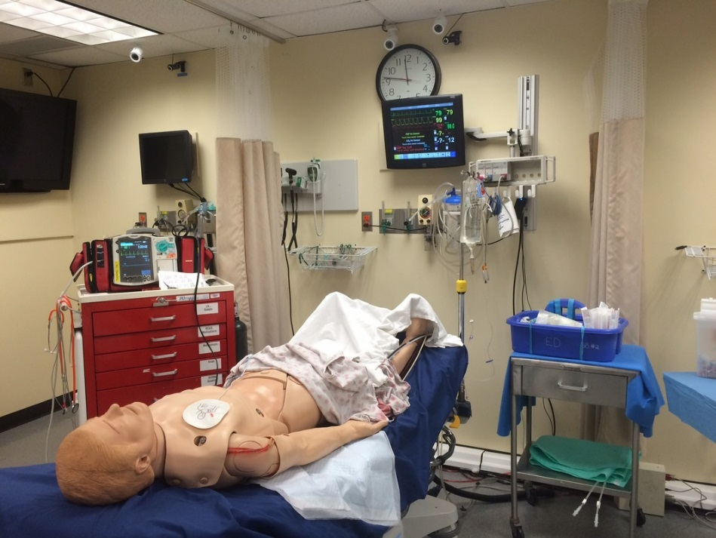
Simulation Center in Kettering: The center is equipped with high-tech manikins for hands-on training of medical students. There are different manikins for different cases.
Notes:
The Cox Simulation Center in Kettering is helpful for hands-on training for medical students. The center is equipped with high-tech manikins for training pediatric, cardiac and surgery cases. Expired medicines such as gel are used for training purposes only. There is a control room where the instructor responds as a patient and controls what is displayed on the screen. The x-ray images are projected on a separate screen for students to view. The physician in charge of the center, Dr. Ray, is able to change the controls when students give proper medication to the patient. The amazing part about the manikins is that you are able to hear the heartbeat and, in the case of infants, the sound of crying with a single click from the computer. This type of training is very beneficial for medical students before they see patients in the clinic. Students are able to practice without fear on the manikins.

Slide 14
Questions:

Slide 15
References:
Albarwani, S., Al-Saadoon, M., Al-Rawas, O., Al-Yaarubi, S., Al-Abri, R., Al-Lamki, L., & Tanira, M. O. (2014). Reflections on the academic accreditation of the MD programme of the College of Medicine & Health Sciences, Sultan Qaboos University, Oman. Sultan Qaboos University Medical Journal, 14(1), e7–e11.
Allen, J. (2014). The greening of your law office: Moving toward a paperless practice. American Journal of Family Law, 28(3), 148-152.
Atkinson, D., & Siew L. (2013). Improving assessment processes in higher education: Student and teacher perceptions of the effectiveness of a rubric embedded in an LMS. Australasian Journal of Educational Technology, 29(5), 651-666.
Billings, D. M. (2005). From teaching to learning in a mobile, wireless world. Journal of Nursing Education, 44(8), 343.
Hains, B. & Smith, B. (2012). Students-centered course design: Empowering students to become self-directed learners. Journal of Experimental Education, 35(2), 357-374.
Lynn University (2013). A mini revolution. Retrieved from http://www.lynn.edu/about-lynn/news-and-events/news/media/2013/11/a-mini-revolution.pdf
Meyer, B. (2008). The process of implementing a paperless classroom in teacher education using an electronic portfolio system. Mountainrise, 5(1), 1-10.

Slide 16
References:
Newhouse, C. P. (2013). Computer-based exams in schools: Freedom from the limitations of paper? Research & Practice in Technology Enhanced Learning, 8(3), 431-447.
Radovic-Markovic, M. (2010). Advantages and disadvantages of e-learning in comparison to traditional forms of learning. Annals of the University Of Petrosani Economics, 10(2), 289-298.
Smith, M., & Cline, M. (2011). Inexpensive options for a high-tech learning environment. Journal of Science Education & Technology, 20(6), 785-789.
Sokol, J. (2009). Get the right start with electronic health records: Practitioner finds that going paperless improves office efficiency and the quality of medical care. Ocular Surgery News, 27(19), 72.
Whistler, V. R. (2010). Going green in a paperless classroom. Journal of Technology Integration in the Classroom, 2(2), 45-56.

